Slide 1
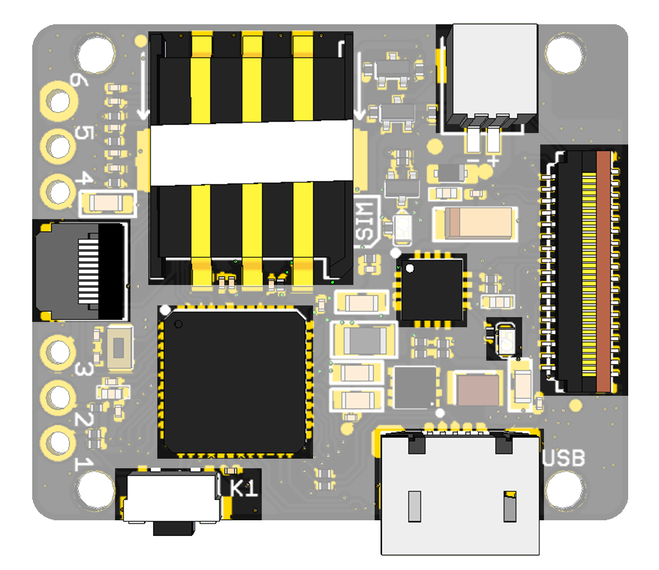
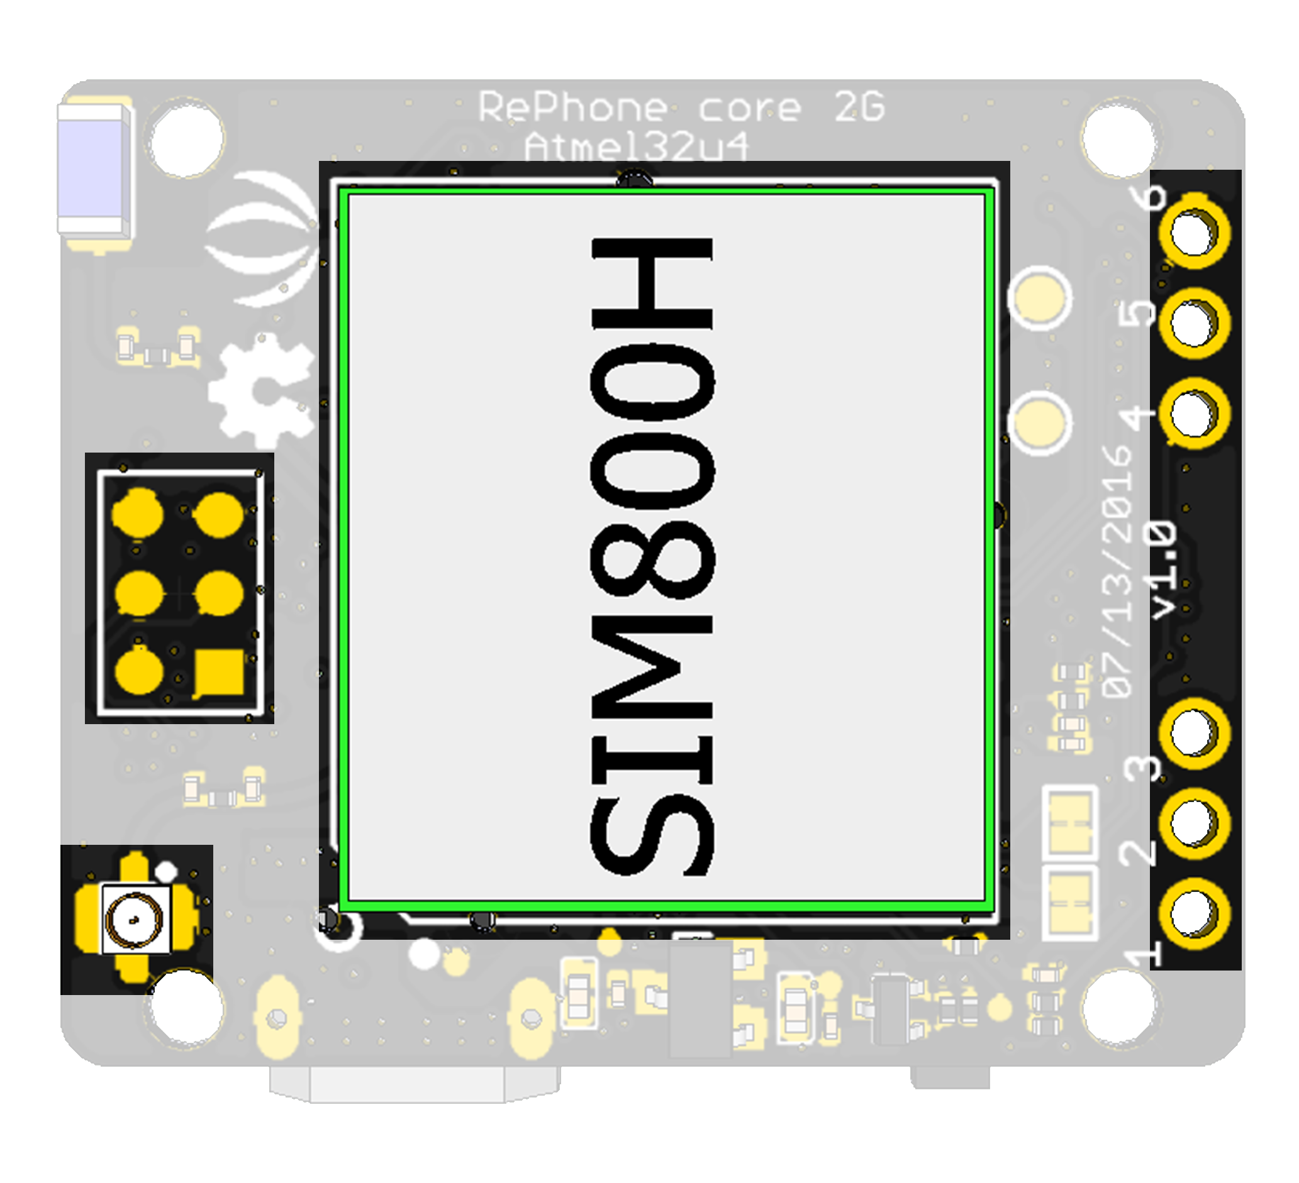
TOP
BOTTOM
6
5
1
4
A
D
C
9
7
8
2
3
B

Slide 2
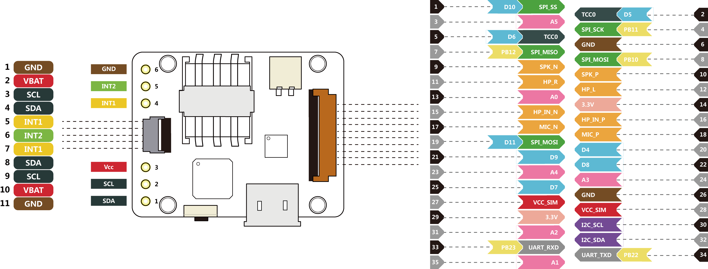

Slide 3
Download AT Command

